Slide 1
Software Design and Architecture
Lecture-6

Slide 2
More GRASP Patterns
Polymorphism
Pure Fabrication
Indirection
Protected Variation (Don’t talk to Strangers )

Slide 3
Polymorphism
Polymorphism is a fundamental principle in designing how a system is organized to handle similar variations.
Most important basic strategic pattern in object-oriented design.
Easily extended to handle new variations.

Slide 4
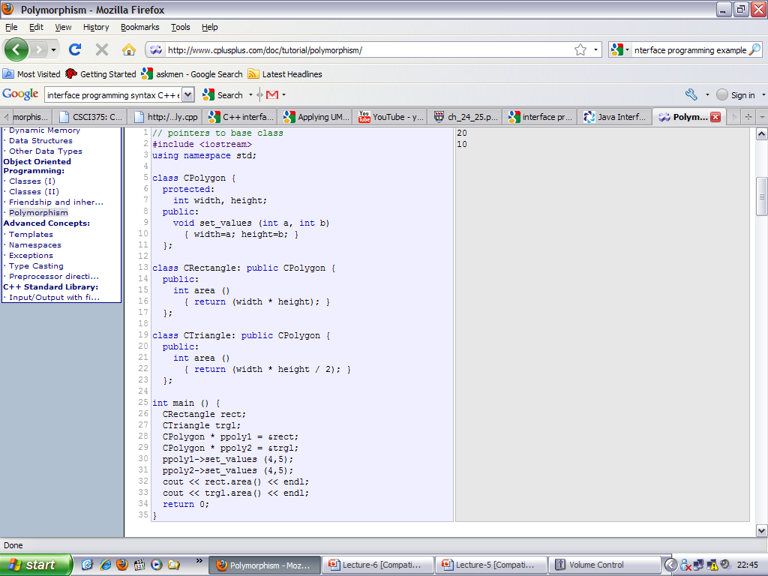

Slide 5
Polymorphism - pattern
Problem
  How to handle alternatives based on type.
  How to create pluggable software components.
Solution
  When related behaviours vary by type, assign responsibility to the types for which the behaviour varies.
  Create a polymorphic operation for each type for which the behavior varies.

Slide 6
Polymorphism
In this context, it means "giving the same name to services in different objects" when the services are similar or related.
Do not test for the type of an object and use of conditional logic to perform varying alternatives based on type.

Slide 7
Example 1
Problem
  Who should be responsible for authorizing different kinds of payment in the point-of-sale example?
The behaviour of authorizing varies by the kind of payment:
  Cash
  Credit Card
  Cheque

Slide 8
Example 1
Solution
  Assign the responsibility for authorizing to each payment type, implemented with a polymorphic authorize operation.
  The implementation of each authorize operation will be different.

Slide 9
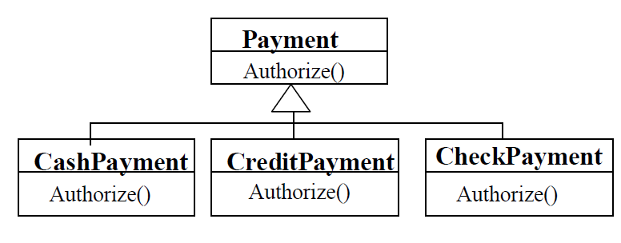
Solution: use subclassing. Make subclass objects responsible for their own behavior and let proper behavior be invoked automatically by subclass type.

Slide 10
Future Variations
Adding a new type of payment, e.g. debit card.
The debit payment class with have its own polymorphic authorize operation.
Minor impact on existing design.

Slide 11
Example 2
There are multiple external third-party tax calculators that must be supported, the system needs to be able to integrate with different ones.
Each tax calculator has a different interface, so there is similar but varying behavior to adapt to each of these interfaces.
One product may support a raw TCP socket protocol, another may offer a SOAP interface, and a third may offer a Java RMI interface.

Slide 12
Applying Polymorphism to POS
What objects should be responsible for handling these varying external tax calculator interfaces?
Since the behavior of calculator adaptation varies by the type of calculator, by Polymorphism, we should assign the responsibility for adaptation to different calculator (or calculator adapter) objects themselves, implemented with a polymorphic getTaxes operation.
Each calculator adapter would have a different implementation of getTaxes.

Slide 13
A design based on assigning responsibilities by Polymorphism can be easily extended to handle new variations.
For example, adding a new calculator adapter class with its own polymorphic getTaxes method will have minor impact on the existing design.

Slide 14
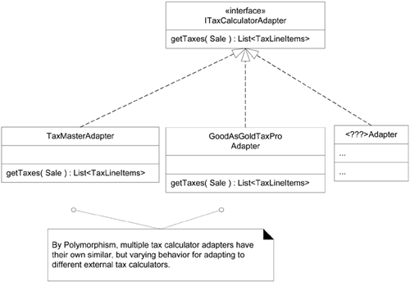

Slide 15
Example 3 : Monopoly
How to Design for Different Square Actions?
–when a player lands on the Go square, they receive $200.
–when a player lands on the Income Tax square he pays tax
–when a player lands on GoJail…
•Solution: Create a polymorphic operation for each type for which the behavior varies.
–It varies for the types (classes) RegularSquare, GoSquare, and so on.
•What is the operation that varies?
–It's what happens when a player lands on a square.
•Thus, a good name for the polymorphic operation is landedOn.

Slide 16
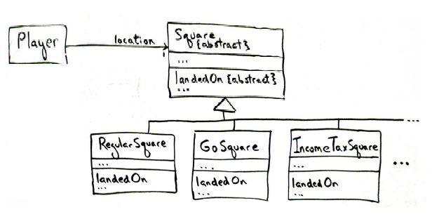
Example 3: Monopoly Class Diagram

Slide 17
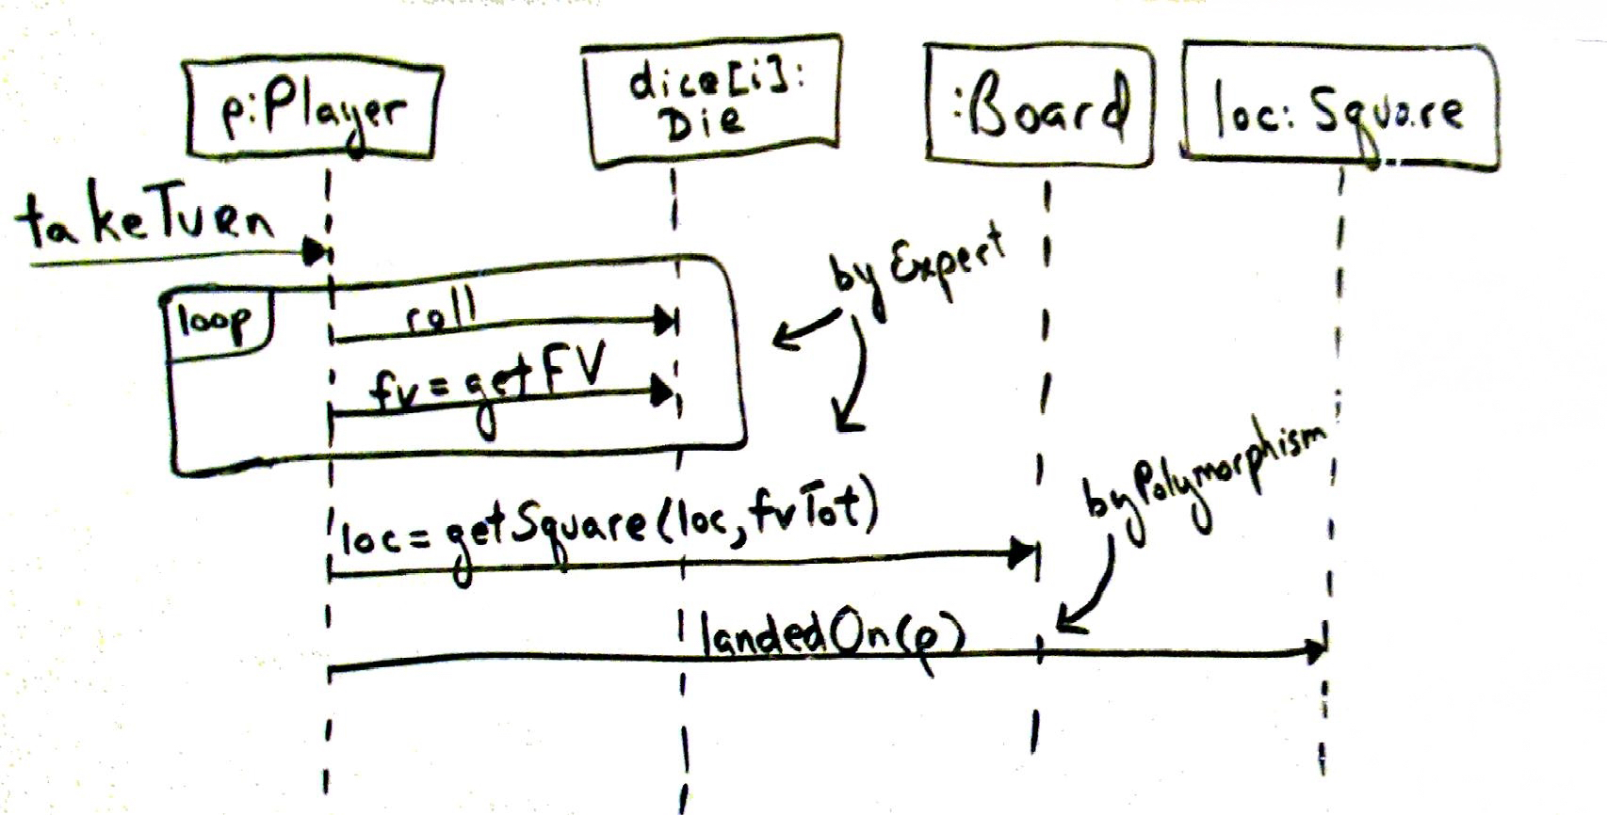
Example 3 : Monopoly
How should the interaction diagrams evolve?
What object should send the landedOnmessage to the square that a player lands on?
Answer: Playersoftware object because it already knows its location square (the one it landed on),
  and so by Expert, class Player is a good choice to send the message, as a Player already has visibility to the correct square.
Naturally, this message should be sent at the end of the takeTurn() method.

Slide 18
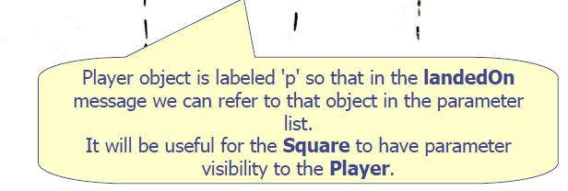
Example 3 : Monopoly (Sequence Diagram)

Slide 19
When to Design with Interfaces?
Polymorphism implies the presence of abstract superclasses or interfaces in most OO languages.
When should you consider using an interface?
The general answer is to introduce one when you want to support polymorphism without being committed to a particular class hierarchy.

Slide 20
Polymorphism - Benefits
Extensions required for new variations are easy to add.
New implementations can be introduced without affecting clients.

Slide 21
Pure Fabrication Pattern

Slide 22
Why need Pure Fabrication?
Object-oriented designs are sometimes characterized by implementing, as software classes, representations of concepts in the real-world problem domain to lower the representational gap; for example a Sale and Customer class.
However, there are many situations in which assigning responsibilities only to domain layer software classes leads to problems in terms of poor cohesion or coupling, or low reuse potential.

Slide 23
Pure Fabrication - pattern
Problem
  What object should have the responsibility, when you do not want to violate High Cohesion and Low Coupling, or other goals, but solutions offered by Expert (for example) are not appropriate?
Solution
  Assign a highly cohesive set of responsibilities to an artificial class - a fabrication.

Slide 24
Fabrication
An artificial or convenience class that does not represent a problem domain concept - something made up, to support high cohesion, low coupling, and reuse.
Such a class is a fabrication of the imagination.

Slide 25
Why fabrication is “pure”?
Ideally, the responsibilities assigned to this fabrication support high cohesion and low coupling, so that the design of the fabrication is very clean, or pure, hence a pure fabrication.
Finally, in English pure fabrication is an idiom that implies making something up, which we do when we're desperate!

Slide 26
Example
For example, suppose we need to save Sale instances in a relational database.
By Information Expert, there is some justification to assign this responsibility to the Sale class itself, because the sale has the data that needs to be saved.
But……

Slide 27
Consequences
A large number of supporting database operations
  Not related to other Sale operations = low cohesion.
Coupling to the database interface
  Coupling to another system’s interface, not even another domain object!

Slide 28
What to do?
Thus, even though Sale is a logical candidate by virtue of Information Expert to save itself in a database, it leads to a design with low cohesion, high coupling, and low reuse potential: exactly the kind of desperate situation that calls for making something up.

Slide 29
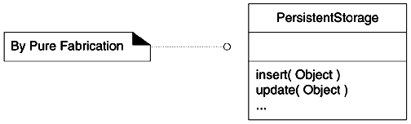
Solution
A reasonable solution is to create a new class that is solely responsible for saving objects in some kind of persistent storage medium, such as a relational database; call it the PersistentStorage.
This class is a Pure Fabrication, a figment of the imagination.

Slide 30
Pure Fabrication helps….
This Pure Fabrication solves the following design problems:
  The Sale remains well-designed, with high cohesion and low coupling.
  The PersistentStorage class is itself relatively cohesive, having the sole purpose of storing or inserting objects in a persistent storage medium.
  The PersistentStorage class is a very generic and reusable object.

Slide 31
Benefits
  High cohesion
  High reuse potential
Potential Problems
  Not object-centric: may lead to a process-oriented design implemented in an object-oriented language.

Slide 32
Indirection

Slide 33
Indirection - Problem
Where to assign a responsibility, to avoid direct coupling between two (or more) things?
How to de-couple objects so that low coupling is supported and reuse potential remains higher?

Slide 34
Indirection - Solution
Assign the responsibility to an intermediate object to mediate between other components or services so that they are not directly coupled.
The intermediary creates an indirection between the other components.

Slide 35
In other words ....
To avoid direct coupling between objects, assign an intermediate object as a mediator
  Recall that coupling between two classes of different subsystems can introduce maintenance problems
  Another possibility is that two classes would be otherwise reusable (in other contexts) except that one has to know of the other
    Coupling the two objects would reduce the reuse contexts to where both abstract concepts were relevant together
      The objects could not be reused separately

Slide 36
Example ..
e.g. Consider an application for managing group work
  Employee instances might need to be coupled to Project instances
  However, potential for reuse of both Employee and Project is high
One solution is to assign a class (Assignment) to couple the two classes
  In this case, the class represents an association class (a class that represents an association)

Slide 37
Association Class
An association class is used to model an association as a class. Association classes often occur in many-to-one and many-to-many associations where the association itself has attributes.
As an example, consider a many-to-many association between classes Person and Company. The association could have properties; e.g. salary, jobClassification, startDate, etc. In this case, the association is more correctly modeled as an ‘association class’ with attributes rather than trying to fold the attributes into one of the classes in the association.
An association class is rendered by a dashed line from the association to the class rectangle.

Slide 38
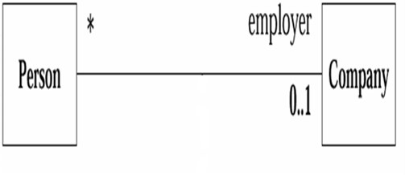
startDate
nature_of_Employement
employement_contract_specs
If these characteristics are pushed to either class, cohesion will be violated, therefore its more appropriate to model this association as a class

Slide 39
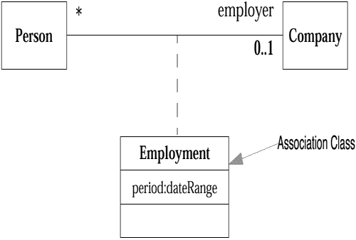

Slide 40
Example ...
The Façade pattern is another example of Indirection
  The Façade prevents coupling classes in two different subsystems
Classes in one subsystem communicate directly with the Façade
  The Façade communicates with the correct subsystem component
Thus, changes to the structure of the subsystem will not affect the user of the subsystem, thanks to the Façade

Slide 41
Example (POST Application)
The Pure Fabrication example of decoupling the Sale from the relational database services through the introduction of a PersistentStorage class is also an example of assigning responsibilities to support Indirection.
The PersistentStorage acts as a intermediary between the Sale and the database.

Slide 42
Protected Variations
(Don’t talk to strangers/Law of Demeter)

Slide 43
Protected Variations - Problem
How to design objects, subsystems, and systems so that the variations or instability in these elements does not have an undesirable impact on other elements?

Slide 44
Protected Variations - Solution
Identify points of predicted variation or instability; assign responsibilities to create a stable interface around them.
The term "interface" is used in the broadest sense of an access view; it does not literally only mean something like a Java interface.

Slide 45
Protected Variations - Example
The prior external tax calculator problem and its solution with Polymorphism illustrate Protected Variations.
The point of instability or variation is the different interfaces or APIs of external tax calculators.
The POS system needs to be able to integrate with many existing tax calculator systems, and also with future third-party calculators not yet in existence.
Situation of switching to multiple databases

Slide 46
Information Hiding and PV
How does Information Hiding helps achieving “Protected Variations”?

Slide 47
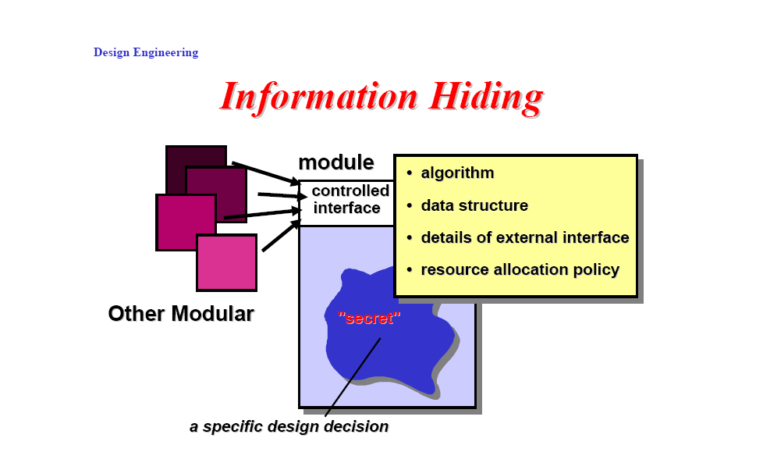
Information Hiding and PV
Reduces the likelihood of “side effects”
Limits the global impact of local design decisions
Emphasizes communication through controlled
interfaces
Discourages the use of global data
Leads to encapsulation -- an attribute of high quality
design
Results in higher quality software

Slide 48
Polymorphism and PV
How does use of Polymorphism and Interface helps in achieving “Protected Variations”?
The Protected Variations pattern protects elements from the variations on other elements (objects, systems, subsystems) by wrapping the focus of instability with an interface and using polymorphism to create various implementations of this interface.

Slide 49
Law of Demeter
(Talk to your Friends, not Strangers)
Protected Variations is achieved by Polymorphism, Indirection, Encapsulation etc
An object should send messages only to following objects:
– itself (this object)
– an attribute of this
– a parameter of one of its methods
– an object created within this method
– elements of a collection (which is an attribute of this)
Avoid (method chaining) foo.getA().getB().getC().getD().getE().getF();

Slide 50
Law Demeter
(Talk to your Friends, not Strangers)
Your method can call other methods in its class directly
Your method can call methods on its own fields directly (but not on the fields' fields)
When your method takes parameters, your method can call methods on those parameters directly.
When your method creates local objects, that method can call methods on the local objects.
but
One should not have a chain of messages a.getB().getC().doSomething() in some class other than a's class.

Slide 51
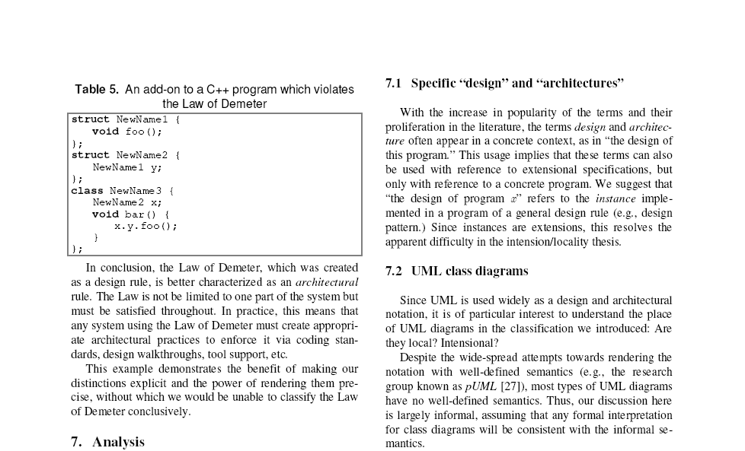
C++ Program that violates the Law of Demeter

Slide 52
Object Form of Law of Demeter
(Do not talk to strangers)
Assignment
What is an Object form of “Law of Demeter”. Give an example of a short piece of code demonstrating it.

Slide 53
Suggested Reading
Applying UML and Patterns, 3rd edition, Craig Larman.
Chapter 25, Sections 25.1 and 25.2.

